Slide 1

AURA
Assembly of University research administrators
February 22, 2022

Slide 2
AGENDA
Effort Reporting Program Kim Vanzant
    System Upgrade
    Training Program and Schedule
    HOOP 93 Policy Changes
SRA LevelUp Training Program for Research Admins Tiffany Sagers
Login.gov and Other Grant Updates Carmen Martinez
Q&A Kathy Kreidler

Slide 3
Effort reporting program

Slide 4
Effort reporting
An Effort Report is a certified statement of how a faculty or staff member spent time across all UTHealth activities.
It must:
  Be a reasonable estimate of percentage of time spent
  Be completed semi-annually by the due date
  Comply with federal rules

Slide 5
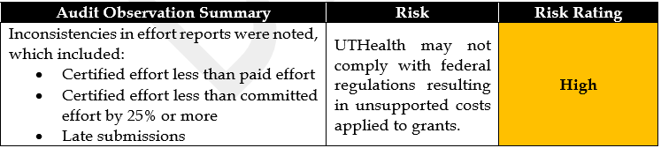
Effort reporting
Audited Regularly:
  Annually during audit of Federal awards
  Throughout the year by various granting agencies (e.g. CPRIT)
  By Internal Audit Services (audit results below)

Slide 6
Effort reporting
Effort Reporting Task Force was formed in March, 2021 to redesign our Effort Reporting Program:
  Upgrade Effort Reporting System
  Launch New Training Program
  Revise Effort Reporting Policy

Slide 7
Effort reporting
System Upgrade:
Now “ECC” or Employee Compensation Compliance
Changes to semi-annual reporting on the fiscal year
    Next Reporting period will be 8 months: 7/1/21-2/28/22
Introduces Project Based Reporting
    One Effort Report per project for non-faculty, payroll based only

Slide 8
Effort reporting
Reports for department to review throughout the year
Flag on projects subject to salary cap
New columns added:
    Project start and end dates
    Originating sponsor
    Cost share
        % IBS or cap salary + % cost share = Total Effort

Slide 9
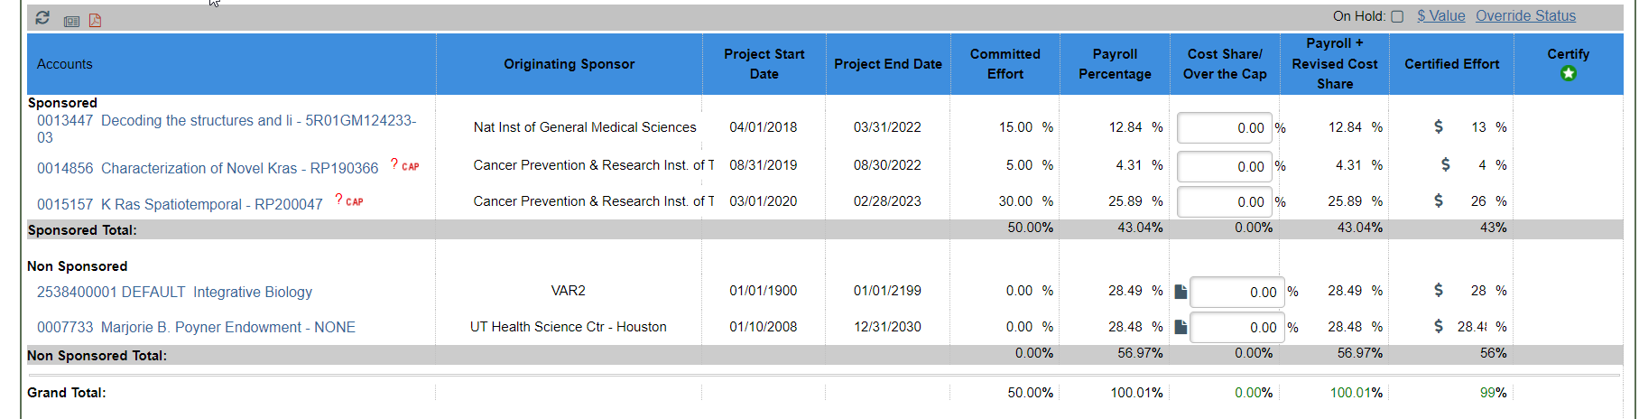
Effort reporting
Individual (faculty) Certification:

Slide 10
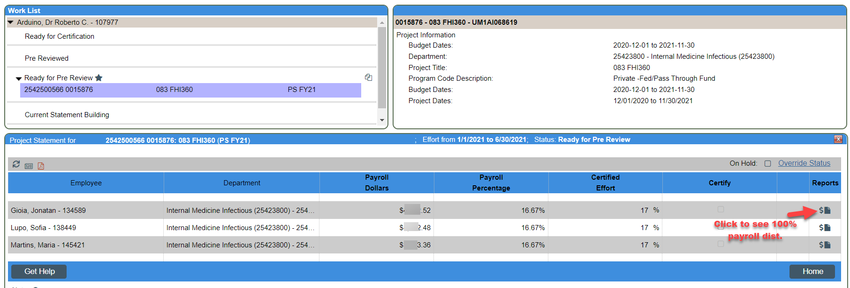
Effort reporting
Project Certification:

Slide 11
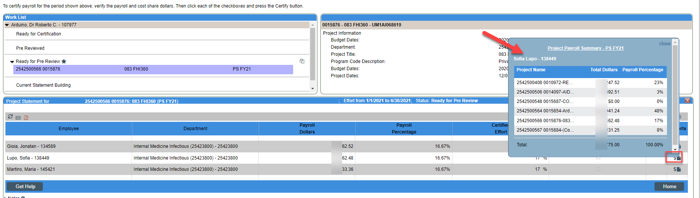
Effort reporting
Project Certification:

Slide 12
Effort reporting
Training Program:
Two Learn2Succeed Modules (available year-round)
Mandatory for effort coordinators and faculty who must certify. Anyone else? Annual or semi-annual training?
Modules will be assigned to users by SPA Training Team
      Effort Reporting Overview
      ECC System
User guides/job aids on SPA website

Slide 13
Effort reporting
Training Program (for 1st effort period in ECC):
Vendor led system training sessions (90 minutes)
      One for effort coordinators and one for faculty
Effort Labs
      SPA assisted open sessions during next effort pre-review period (UCT 11th floor IT computer training room)

Slide 14
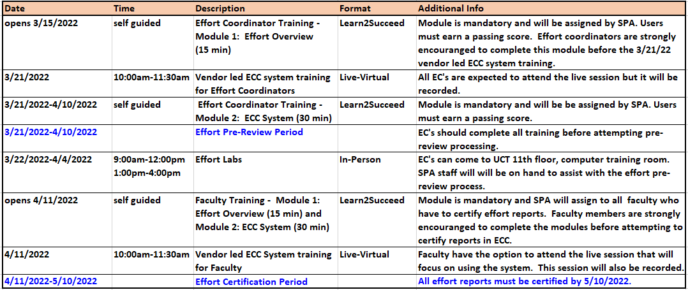
Schedule for next effort certification period
7/1/21-2/28/22

Slide 15
Effort reporting
HOOP 93 EFFORT REPORTING POLICY REVISIONS:
Jan, 2022 Team Completed Revisions
Jan, 2022 Interfaculty Council pre-reviewed
Feb, 2022 Approved By Institutional Policy Committee
Mar, 2022 Executive Compliance Committee to Review
Significant Changes:
    Definitions to align with ECC System
    Minimum/Maximum Sponsored Effort clarified
    Policy Enforcement

Slide 16
Thank you!
Effort Reporting Task Force:
School/Department Reps:
Tresa Beverly-Prince MMS, Emergency Medicine
Cynthia Bihm SPH and MMS, IMM
Elaine Embody (ret.) MMS, Family Medicine
Diana Marshall MMS, Biochemistry & Mol Bio
Lenora Trujillo SOD
Charmaine Wilson CSON
SPA Reps:
Valerie Bomben Carmen Martinez
Shannon Gary Troy Roberson
Payam Hassany Tiffany Sagers
Payal Haq Kim Vanzant
Seemin Maredia
HOOP 93 Policy Team:
Faculty Reps:
Pramod Dash, PhD
Sunil Sheth, MD
Muhammad Walji, DDS
School Admin Reps:
Cynthia Bihm
Nancy McNeil
Charmaine Wilson
SPA Reps:
Shannon Gary
Carmen Martinez
Kim Vanzant

Slide 17
SRA levelup training for research admins

Slide 18
Training for research (Sponsored Projects) admins
Old processes, policies and forms
Ahhh, a perfect world….
Changing sponsor rules
Research/SP Faculty
Delayed awards
Staff turnover and vacancies
Department/School G&C Staff
“Putting out fires”
Last minute faculty
SPA
Finding experienced staff
Covid
Audits, legal issues,
…early grant submissions, timely awards, right-sized staff, great communication….

Slide 19

Training for research (Sponsored Projects) admins
Build a foundation of knowledge
“How to think like a
research/SP administrator”
Add the
“UTHealth Way”
policies and processes
Cap with
strong systems
ECC upgrade, START–adding COI module
SPA Training Team

Slide 20
Training for research (Sponsored Projects) admins
SRA LevelUp Micro-credentialing Program:
Builds the Foundation
  Self-paced, on-line modules with knowledge checks and exams
  Designed to teach how to think through the entire world of “grey” that is Research Administration
  Good preparation for Certified Research Administrator Exam
Advanced case study and essay at the end
“Badging” (certificates – attach to signature, LinkedIn)

Slide 21
Training for research (Sponsored Projects) admins
Full module review and update every 2 years
New modules being created
Coming-Soon: NIH focused Mini Modules for JIT learning on a narrow topic (e.g. how to complete a RPPR)
Institutional Membership: unlimited users and modules

Slide 22
Training for research (Sponsored Projects) admins
https://www.srainternational.org/meetings/levelup-program

Slide 23
Login.gov and other grant updates

Slide 24
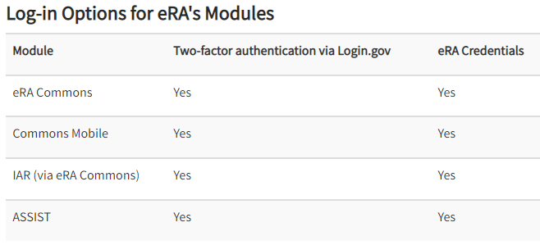
Login.gov
New credentials required for Grants.gov/eRA Commons users beginning Feb 21, 2022
This change to the sign-in process improves user security and complies with Executive Order 14028, improving the nation’s cybersecurity.
Login.gov allows users to access multiple government websites with a single username and password.

Slide 25
Login.gov
For Faculty:
  Link eRA Commons account to Login.gov now
  PIs and key personnel associated with an application or RPPR will be required to transition 45 days after the submission of their competing grant application (Type 1 or 2) or their RPPR
For Admin Staff
  Transition will be required mid-2022
  Non-compliance will lock you out of eRA Commons!

Slide 26
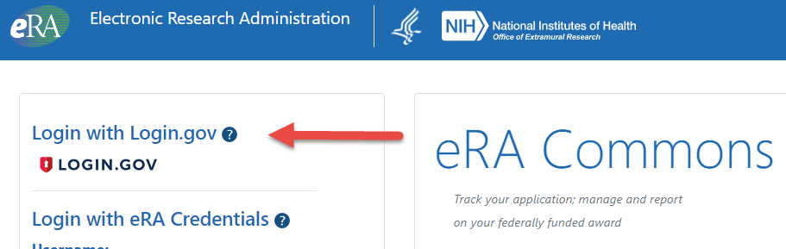
Login.gov
3 Steps to Create Your Login.gov Account
Before you start:
  Make sure your eRA Commons account is active and you know your account password
  Don’t use old bookmarked URLs to access eRA Commons.
    The URL for eRA Commons is https://public.era.nih.gov/commons/
Step 1: Click on the Login.gov option on the eRA Commons home screen

Slide 27
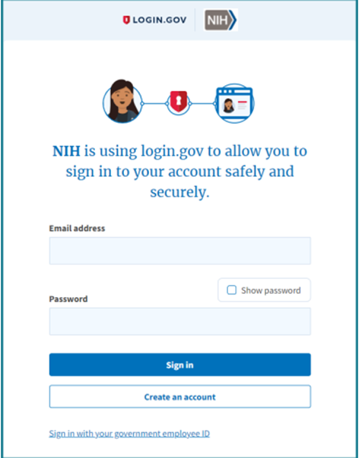
Login.gov
Step 2: Create Login.gov account
  Requires 2-factor authentication
  Choose an authentication method from the available options
  A security code sent by text or voice call is recommended

Slide 28
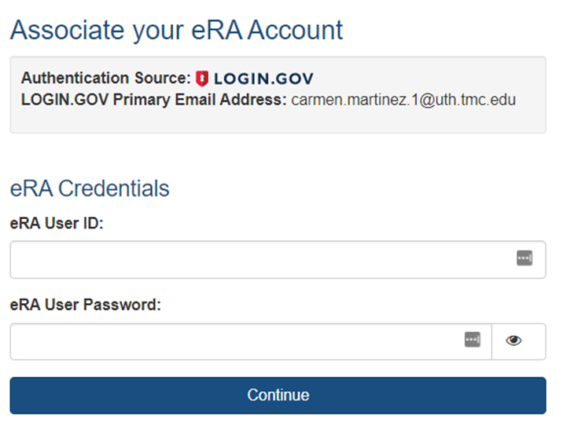
Login.gov
Step 3: Link Login.gov account with eRA Commons
  One-time step only
  Make sure your eRA Commons credentials are correct!
  After validation, your Login.gov account is associated with your eRA Commons account, and you will directly access the eRA Commons
  Note: From this point forward, you must use the Login.gov option on the eRA Commons home screen
  Reference: 2FA_flyer.pdf (nih.gov)

Slide 29
NIH Updates
New Salary Cap of $203, 700
  Applies to all new and non-competing awards effective 1/2/2022
Unique Entity Identifiers
  Replaces DUNS
eRA Commons IDs required for all Key Personnel
  Verify before submission to NIH

Slide 30
Q & A

